Slide 1
ALL ABOUT TEMPERING

Slide 2
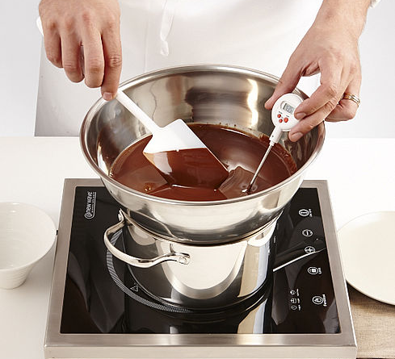
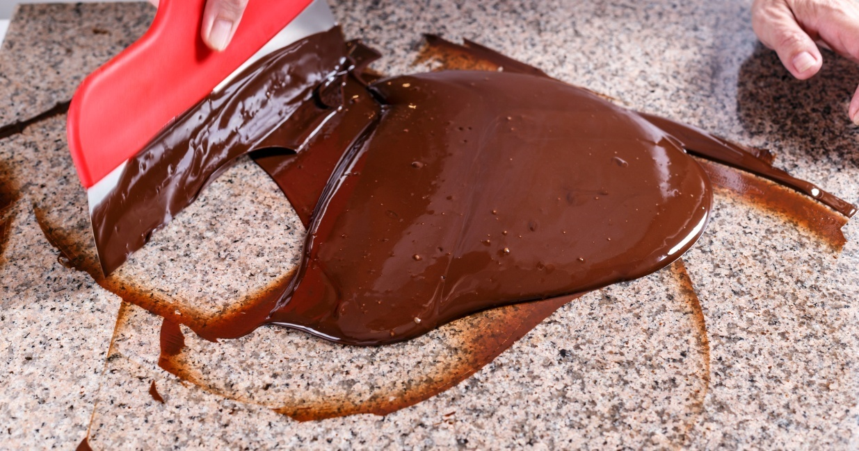
WHAT IS TEMEPRING
Heating and cooling of chocolate to stabilize it is known as tempering chocolate.

Slide 3
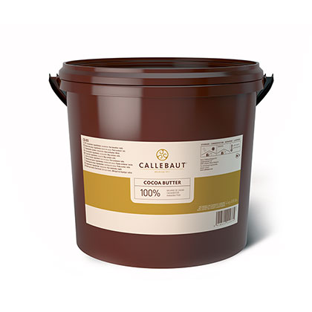
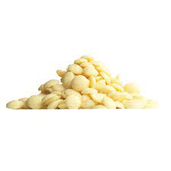
COCOA BUTTER
Cocoa butter can crystallized in any one of 6 different forms
1
2
3
4
5
6
BETA CRYSTAL

Slide 4
BENEFITS OF TEMPERING
Benefits of tempering are:
Helps to harden chocolate
Provides beautiful gloss and delicious snap.
Chocolate contracts during cooling, which makes it easier to unmold.

Slide 5
MILK COVERTURE
TEMPERING
TABLING METHOD
100 g (45C)
1/3rd
2/3rd
33 g
66 g
45C
In the bowl
On the table
45C
27C
30C
27C
Combine
30 C

Slide 6
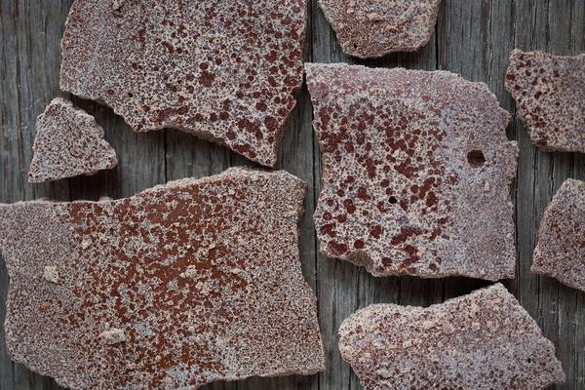
TYPES OF BLOOMS
If the chocolate is not tempered properly or temperatures are not followed
then the final texture results in chocolate bloom
FAT BLOOM: chocolate is heated so much that the butter separates and when the chocolate sets it shows streaks that are discolored and hazy.

Slide 7
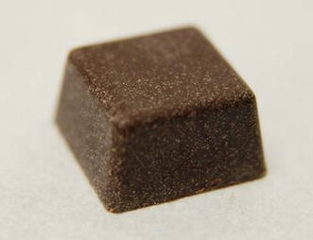
TYPES OF BLOOMS
SUGAR BLOOM: chocolate is allowed to cool too quickly ,the condensation dissolves the sugar present in it and when moisture evaporates, it recrystallizes the sugar, there by giving a hazy and dull appearance.

Slide 8
DARK COVERTURE
TEMPERING
SEEDING METHOD
100 g
90 g
10 g
45C
MELTED
CALLETS
45 C
Combine
31-32C
31-32 C

