Slide 1
Packing and Delivering Chocolates

Slide 2
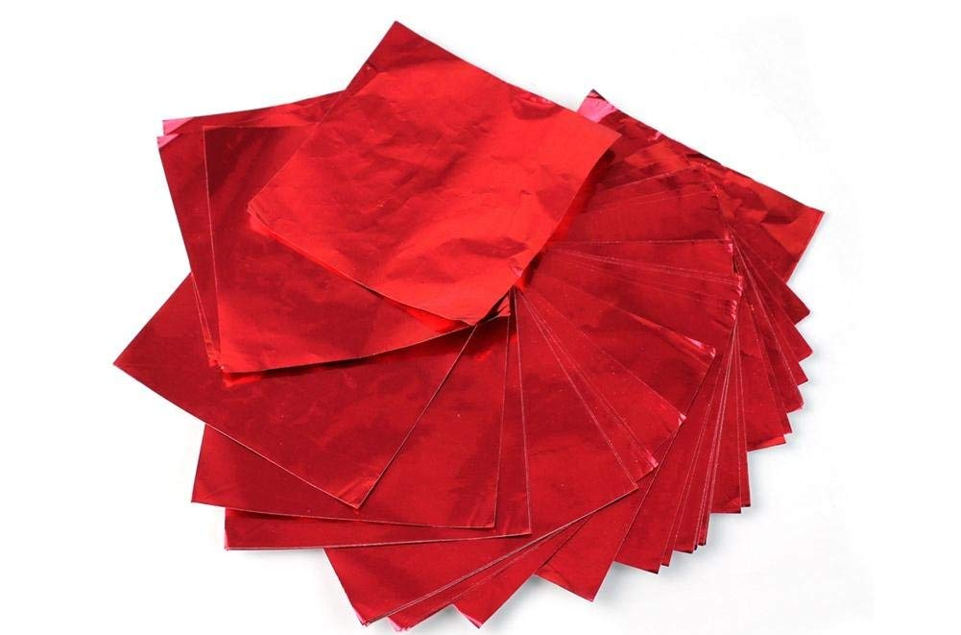
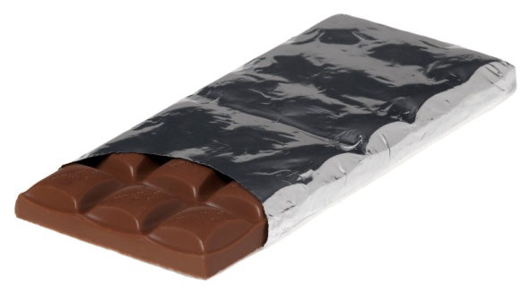
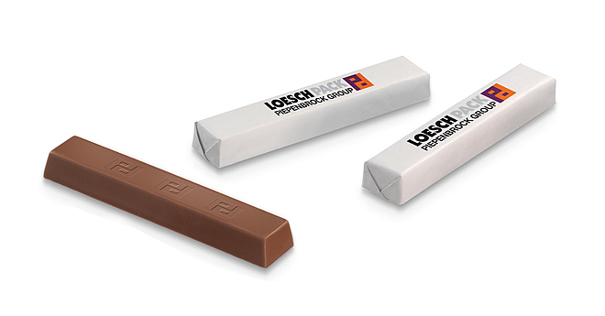
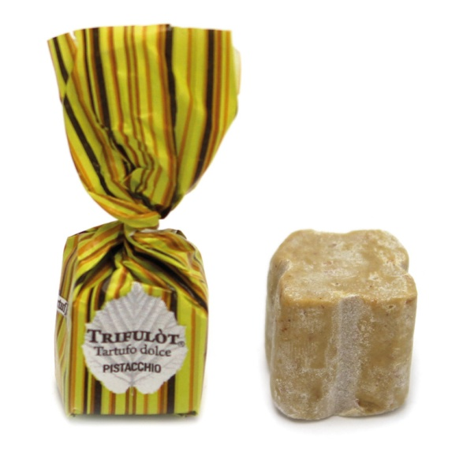
Individual chocolate packing

Slide 3
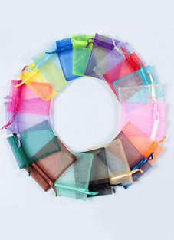
Packing pouches

Slide 4
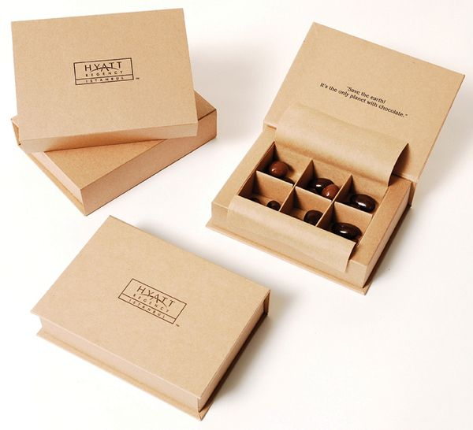
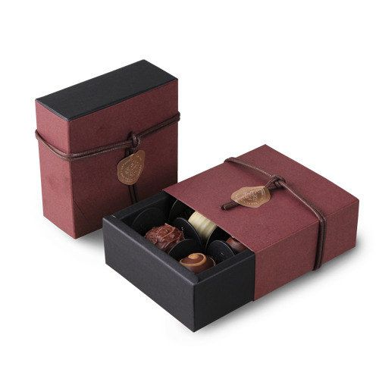
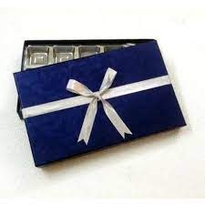
Packing boxes

Slide 5
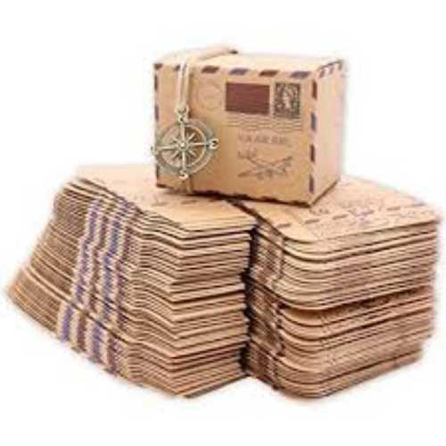
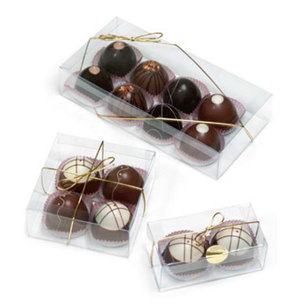
Packing boxes

Slide 6
Shipping or Delivering Chocolates
Purchase overnight shipping for your chocolates, if possible
Chocolate is sensitive to temperature changes and will not look or taste the same after it's melted. If overnight or one-day shipping is an option for your package, choose it to ensure that your chocolates stay in their best condition. As a rule, chocolate doesn't stay in good condition for more than 3 days in the mail.
Avoid shipping chocolates right before a weekend or holiday, as they're likely to sit in a sorting facility for several days. Because chocolate can melt on hot days even with overnight shipping, don't send chocolates during warm seasons.

Slide 7
Pack your chocolate in a box 2-3 times the size of their package.
This will give you enough room for cushioning so the chocolates stay cool and intact. If your box is too tight, the chocolate is more likely to overheat. Avoid shipping chocolates that are not held inside a container, wrapper, or plastic bag. Unwrapped chocolate is more likely to make a mess when shipped.
You don't have to be exact with your measurements of the package—approximation is fine.

Slide 8
Wrap the chocolates with plastic wrap if it's in a decorative container.
This will keep the container intact while you ship it. Handle the container carefully while wrapping it to avoid breaking the decorations. Try to seal the chocolates as tightly as possible to keep the container secure.Plastic wrap can also protect your chocolates from moisture and help insulate them.

Slide 9
Pad the box with mylar bubble wrap.
Mylar-coated bubble wrap deflects heat and insulates the chocolates to keep them cool. Before placing the chocolates in the box, wrap them in the bubble wrap. After you've put them in, stuff the box with extra bubble wrap if you have room. Don't use newspaper as padding for chocolate, as it won't provide enough cushioning. If you want to add more padding, try packing peanuts instead.
Fill in all of the extra gaps with a packing material to keep your chocolates secure in the box.

Slide 10
Add a final layer of mylar on top.
Before closing the package, place a mylar layer on top approximately the same length and width as the box. This final layer will help keep your chocolates in place if they are bumped or jostled during the shipping process.

Slide 11
Keeping Packed Chocolates Cool
Leave your chocolates in the fridge or freezer until you pack them.
Until you transfer your chocolates to its decorative or shipping container, make them cold for as long as possible. After you've packed your chocolates, put them back in the fridge until you either deliver or ship them. While in the fridge or freezer, keep your chocolates in an airtight container. Sandwich bags with a zipper are ideal.

Slide 12
Keep your package out of direct sunlight until you ship or deliver it.
When exposed to sunlight, chocolate melts quickly. If you've taken your chocolates out of the fridge, keep them in a cool place away from bright lights and heat.

Slide 13
Use gel cold packs to chill the chocolates.
Put a cold pack in the freezer and, when it's cold, slip it in your chocolate's container or shipping box. To protect your chocolates from moisture, place it in a zipper sandwich bag before you place it in the package. Don't use ice packs to cool your chocolates, as these melt and can ruin their packaging.
To keep your chocolates cold while shipping them, you can leave the gel pack in the box.

Slide 14
Try dry ice as an alternative to cold packs if you're shipping your chocolates.
Dry ice keeps chocolate cold for longer but can irritate your skin. Put on gloves and goggles, and place your chocolates in a sealed plastic container before packing it. Ask your local shipping store how much dry ice you can put in a package, then place it alongside the chocolates and bubble wrap. If you pack your chocolates with dry ice, you must write "Contains Dry Ice" on the package.

